Slide 1


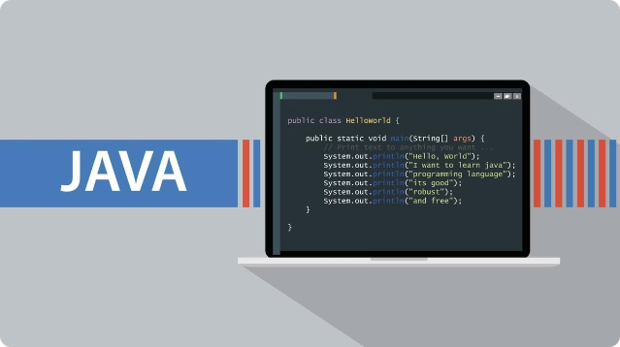
Introduction to the Simple Calculator using Java AWT
This presentation introduces the development of a simple calculator using the Java Abstract Window Toolkit (AWT). We'll delve into its components, working principle, and practical applications.
By Abhinav Dyan Samantara

Slide 2
Overview of Java AWT (Abstract Window Toolkit)
Java AWT is a platform-dependent graphical user interface (GUI) toolkit. It provides a set of classes for creating basic GUI elements, such as buttons, labels, text fields, and windows.
Key Features
Advantages
Disadvantages
AWT is built on top of the native windowing system of the underlying platform, ensuring platform-specific look and feel. It allows developers to create graphical user interfaces that are consistent with the operating system.
Simplicity
Limited functionality
Platform-specific look and feel
Platform-dependent
Lightweight

Slide 3

Components of the Simple Calculator
The Simple Calculator built with Java AWT comprises basic GUI elements that enable users to perform arithmetic calculations.
1
Number Buttons
2
Operator Buttons
Digit buttons (0-9) allow users to input numbers.
Buttons for basic arithmetic operations like addition, subtraction, multiplication, division, percentage, modulus, negation
3
Display Field
4
Equal Button
Displays the input numbers, operators, and the
final result.
Triggers the calculation and displays the result.

Slide 4




Working Principle of the Simple Calculator
The calculator's working principle involves capturing user input, processing calculations, and displaying the results.
User Input
Users interact with the calculator by pressing number and operator buttons.
Input Processing
The program captures user input, stores it in variables, and prepares the data for calculations.
Calculation
When the equal button is pressed, the program performs the specified arithmetic operation
using the stored input values.
Result Display
The calculated result is displayed in the designated field, providing visual feedback to the user.

Slide 5

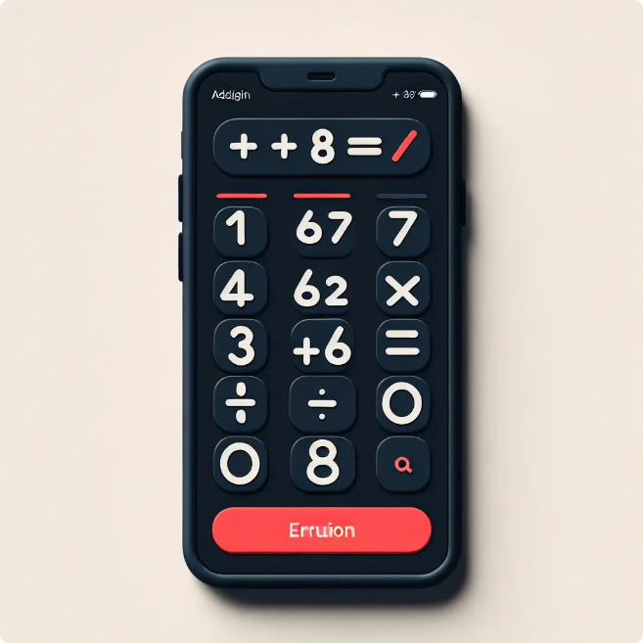
Basic Arithmetic Operations Supported
The simple calculator provides support for a variety of fundamental arithmetic
operations.
Operation
Symbol
Addition
+
Subtraction
-
Multiplication
*
Division
/
Square Root
√
Percentage
%
Modulus
%
Negation
+/-

Slide 6

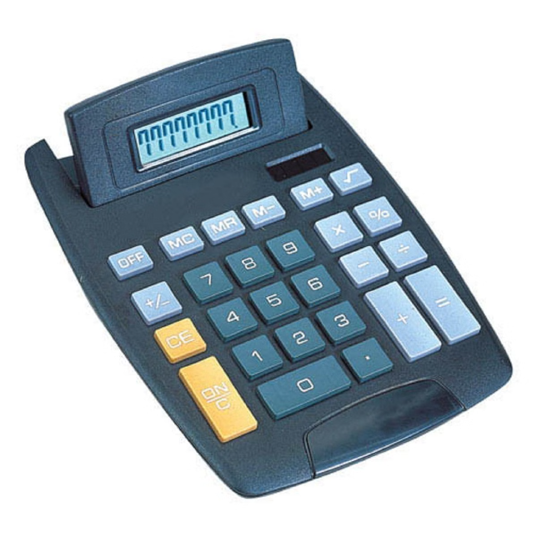
Advantages of the Simple Calculator
The Simple Calculator offers several advantages, making it a useful tool for basic calculations.
User-Friendly
Basic Functionality
Its intuitive interface and straightforward design make it easy for users of all levels to operate.
It provides essential arithmetic operations for everyday calculations.
Lightweight and Fast
The Simple Calculator is designed to be lightweight, consuming minimal system resources and offering quick responses.

Slide 7





Disadvantages of the Simple Calculator
While simple calculators offer advantages, they also come with certain limitations.
Limited Functionality
The Simple Calculator lacks advanced features like trigonometric functions,
logarithms, or scientific calculations.
Error Handling
The Simple Calculator might not provide robust error handling for invalid inputs or
potential calculation errors.
Limited Memory
The Simple Calculator typically lacks memory storage for storing intermediate
results or previous calculations.

Slide 8


Use Cases and Applications of the Simple Calculator
The Simple Calculator finds its use in various scenarios where
basic calculations are required.
1
Personal Use
Individuals use it for daily tasks like budgeting, shopping, and
calculating tips.
2
Educational Purposes
Students in elementary and middle school utilize it for basic arithmetic practice and problem-solving.
3
Business Applications
Simple calculations like discounts, sales tax, or inventory management are facilitated by the calculator.

Slide 9
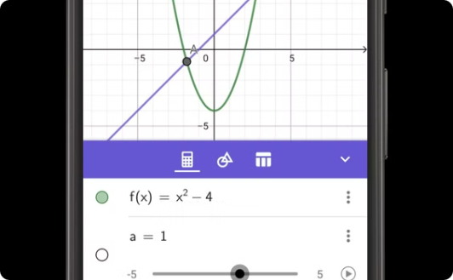
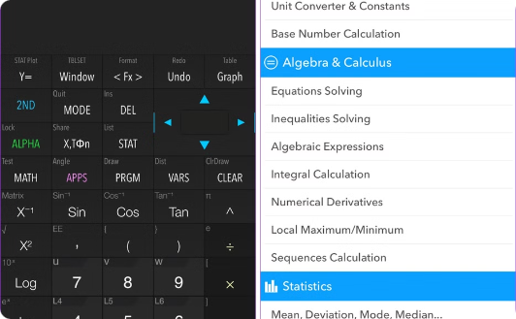
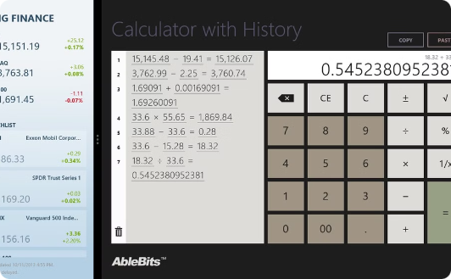
Future Scope and Enhancements
The Simple Calculator can be enhanced to offer more advanced functionality and features.
Graphical Representation
Scientific Functions
Calculation History
Visualizing data or calculations through graphs and charts can enhance the calculator's usability.
Adding trigonometric functions, logarithmic functions, and scientific constants can expand its applications.
Storing and retrieving previous calculations can improve efficiency and aid in error checking.

Slide 10
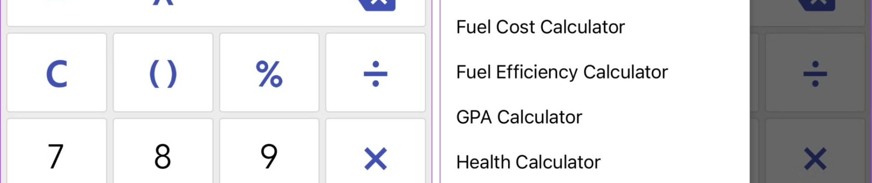
Conclusion and Key Takeaways
The Simple Calculator, built using Java AWT, provides a user-friendly interface for basic arithmetic operations. It finds its application in personal, educational, and business settings.

